Slide 1
Miami Rowing Club Sponsorship Opportunities
MIAMI INTERNATIONAL REGATTA 2025

Slide 2
Why Sponsor?
Miami Rowing Club (MRC) is one of the premier South Florida rowing clubs and is based out of the historic and obvious Miami Marine Stadium Basin
MRC is composed of Youth Rowers from Schools all over Miami and Masters Rowers
MRC crews have competed nationally and internationally and have been featured on local (Miami Herald) and national media (ESPN)
MRC Youth Program alumni attend local and national universities
MRC families are loyal and eager to support our supporters
MRC hosts multiple premier events throughout the year and participates in regattas locally, nationally, and internationally
Blue Blazer Gala
Miami International Regatta
Awards Ceremony
WINTER
SPRING
SUMMER

Slide 3
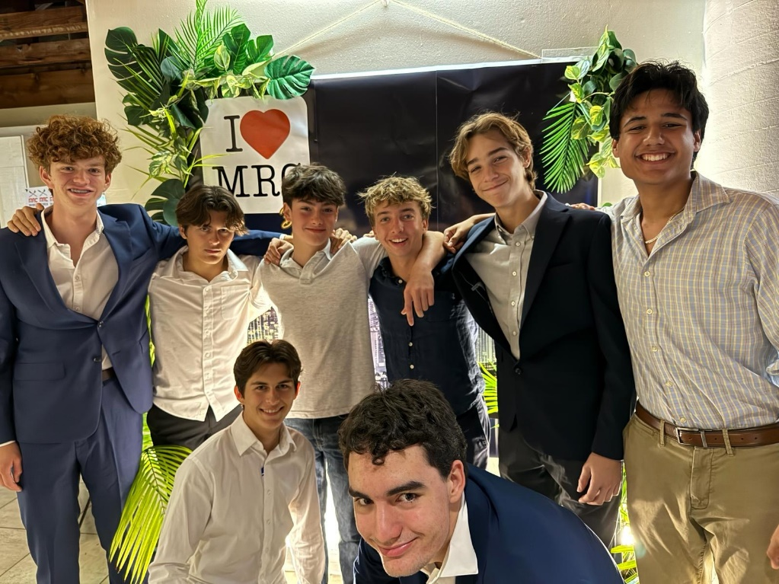
MRC Blue Blazer Gala
March 15, 2025
The MRC Blue Blazer is the signature fundraising event taking place in the evening at the beautiful MRC Boathouse patio with a view of the Miami Marine Stadium and downtown skyline*
Organized entirely by the Miami Rowing Club (MRC)
Silent Auction, Dinner and Dancing
Attracts all MRC families and supporters
Average attendance of over 150 people
* 2025 Event moved to KB Community Center due to City of Miami restrictions
BB Operating Costs (200 participants):
$8000 Food and space rental
$5000 Other Expenses (Decoration, Music, Insurance and rentals)
$4500 Auction Set up (Custom platform, Media, Marketing, Video & Photo)
$250 Visitor services

Slide 4
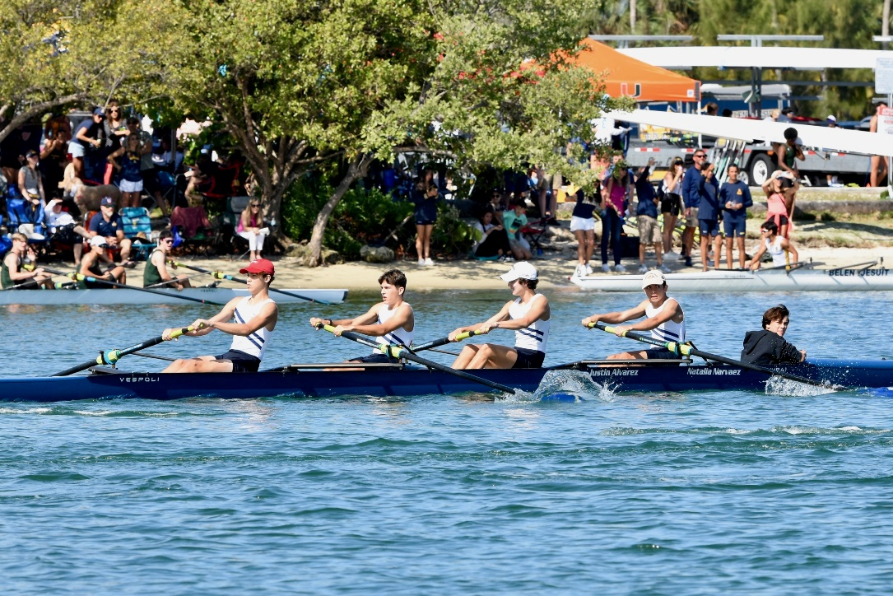
52nd Annual Miami International Regatta
April 5th, 2025
Miami International Regatta (MIR) is the most important regatta in Miami, taking place in the most scenic and historic location of the Miami Marine Stadium Basin on Virginia Key
Organized entirely by the Miami Rowing Club (MRC)
Yearly race with 52 years of history
Attracts on average 15 rowing teams from Florida and US including 5 out of state and international teams
Over 600 participants
Average attendance of over 1500 people
Press and Media Coverage

Slide 5
52nd Annual Miami International Regatta
April 5th, 2025
Why Sponsor?
Brand Visibility
Community Recognition through press, media & social media and significant promotional opportunities
Celebrate tradition and one of the fastest growing youth sports
Align with MRC core values of hard work, respect and persistence
Support community engagement and diversity through scholarship program

Slide 6
Miami International Regatta
April 5th, 2025
$5300
$3500
$10000
$5000
$1400
$3000
$1100
$2300
$6600
$7000
$1300
Race timing, telemetry, and Referees
Course Set Up (incl. lanes and buoys)
Permits, insurance, and security (including the City of Miami, Police, and Fire dept.)
Visitor services, incl. bathrooms and tents
Light towers and Sound rentals
Medals and Trophies
Drone Video and Photos
Referees include travel and lodging
Additional supplies (Fuel, Snacks, High Top tables, Wireless Radios)
Other Operating Expenses (Payroll)
Rental of two (2) generators.
MIR Operating Costs (based on previous years):

Slide 7
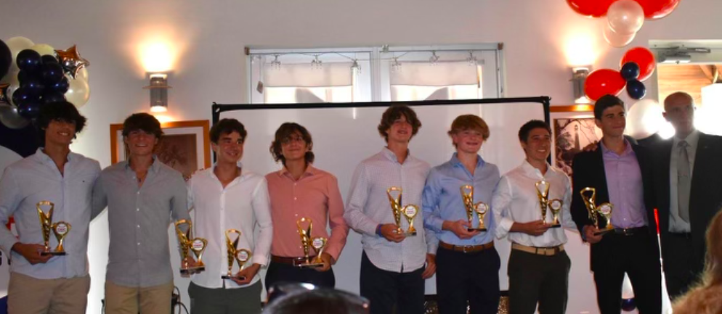
Awards Ceremony
May 15, 2025
A festive and elegant dinner event which brings together all our youth rowers and their families for awards and recognition
Organized entirely by the Miami Rowing Club (MRC)
Top Awards are Rower of Year for Boys and Girls team
Recognition of Graduating Seniors.
Attracts all MRC families and supporters
Average attendance of over 150 people
Awards Ceremony Costs:
$9100
$1700
$1250
Food and space rental (including gratuity, rentals and service fee)
Decoration incl. centerpieces
Trophies and awards

Slide 8
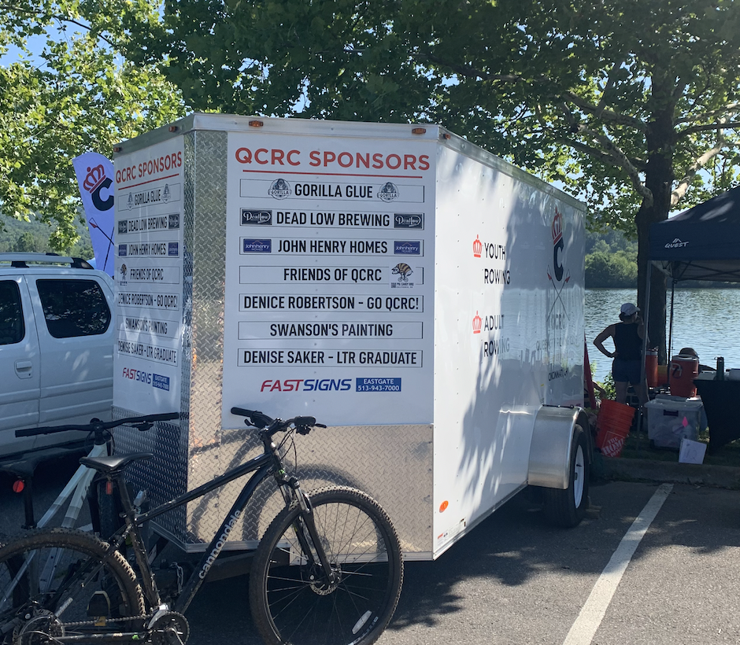
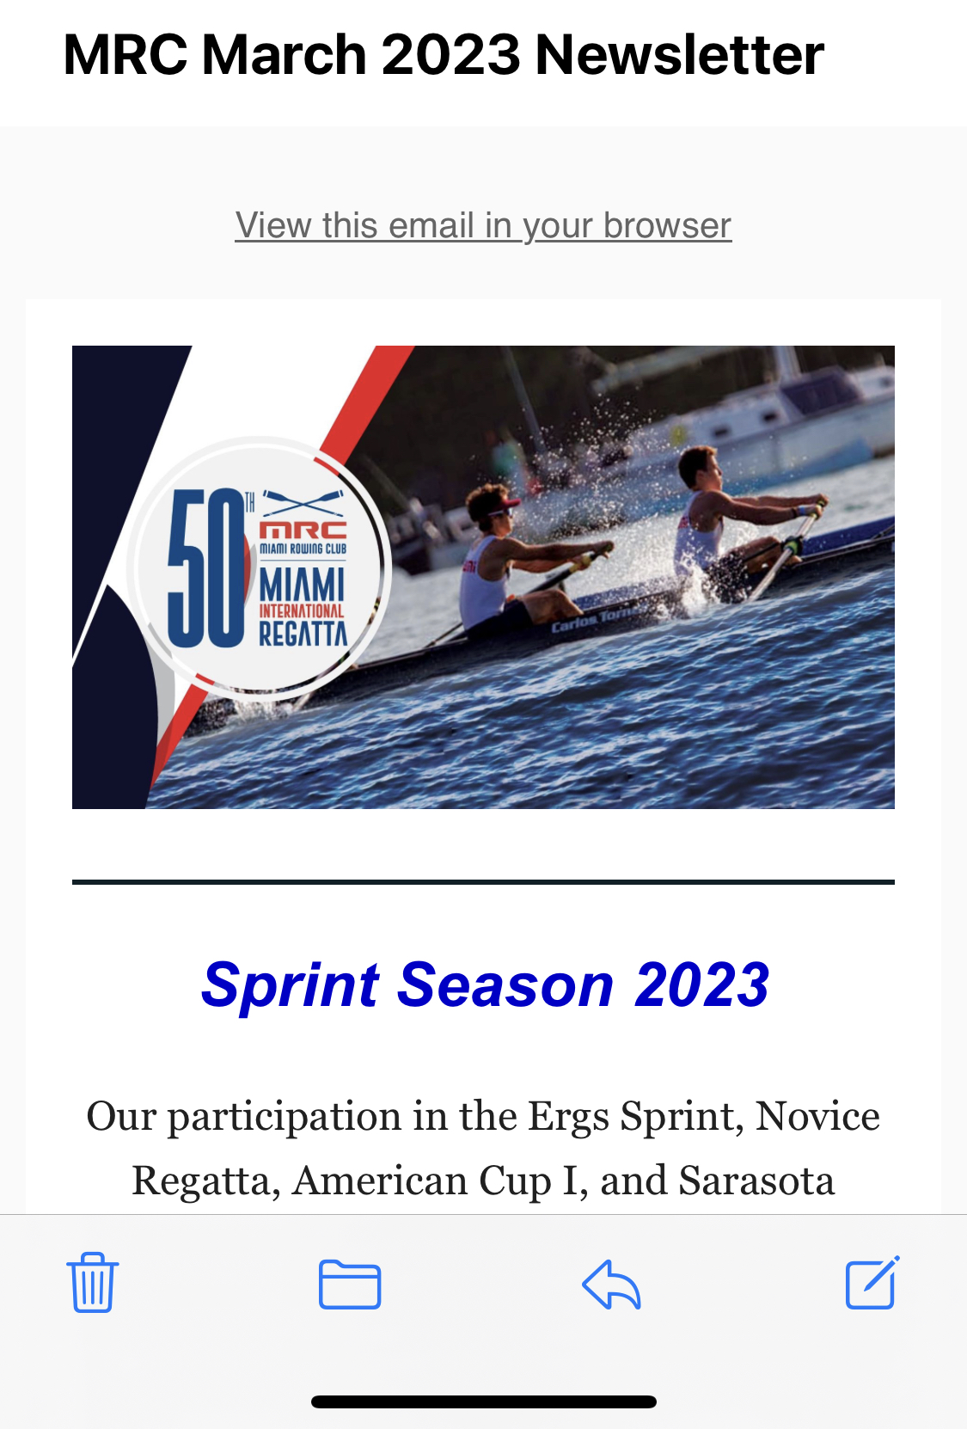
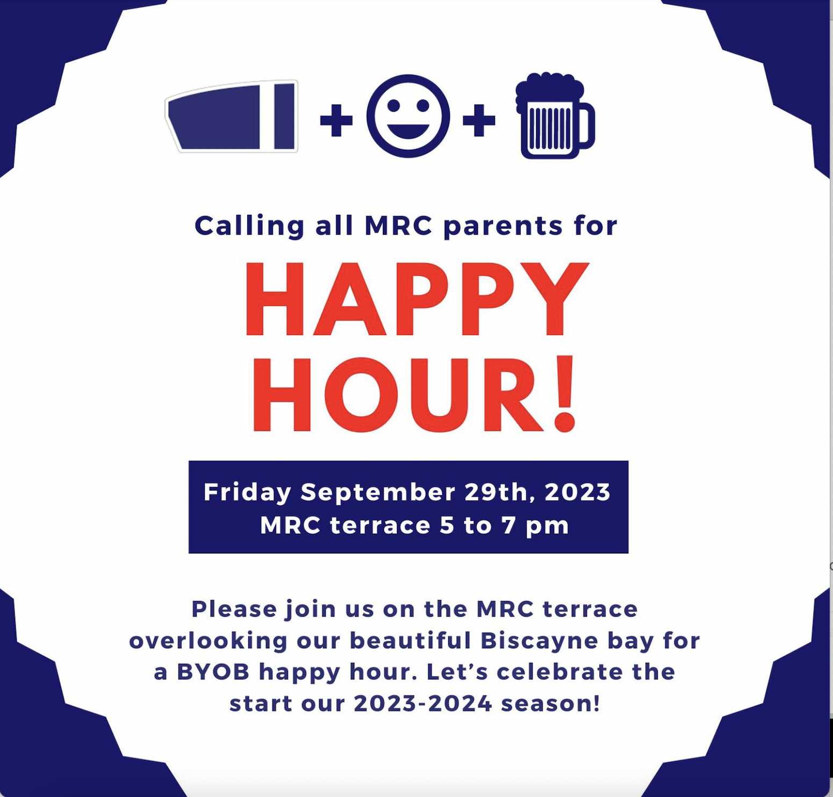
Year-Long Opportunities
2024-2025
Monthly Happy Hour sponsorship - Naming rights across all media
MRC Boat Dock - logo
MRC Launches - logo
MRC Boat Trailer - logo
MRC Spirit Practice Tee – logo
MRC Monthly Newsletter - logo and signage
YOUR NAME HERE
YOUR
NAME HERE
YOUR
NAME HERE

Slide 9
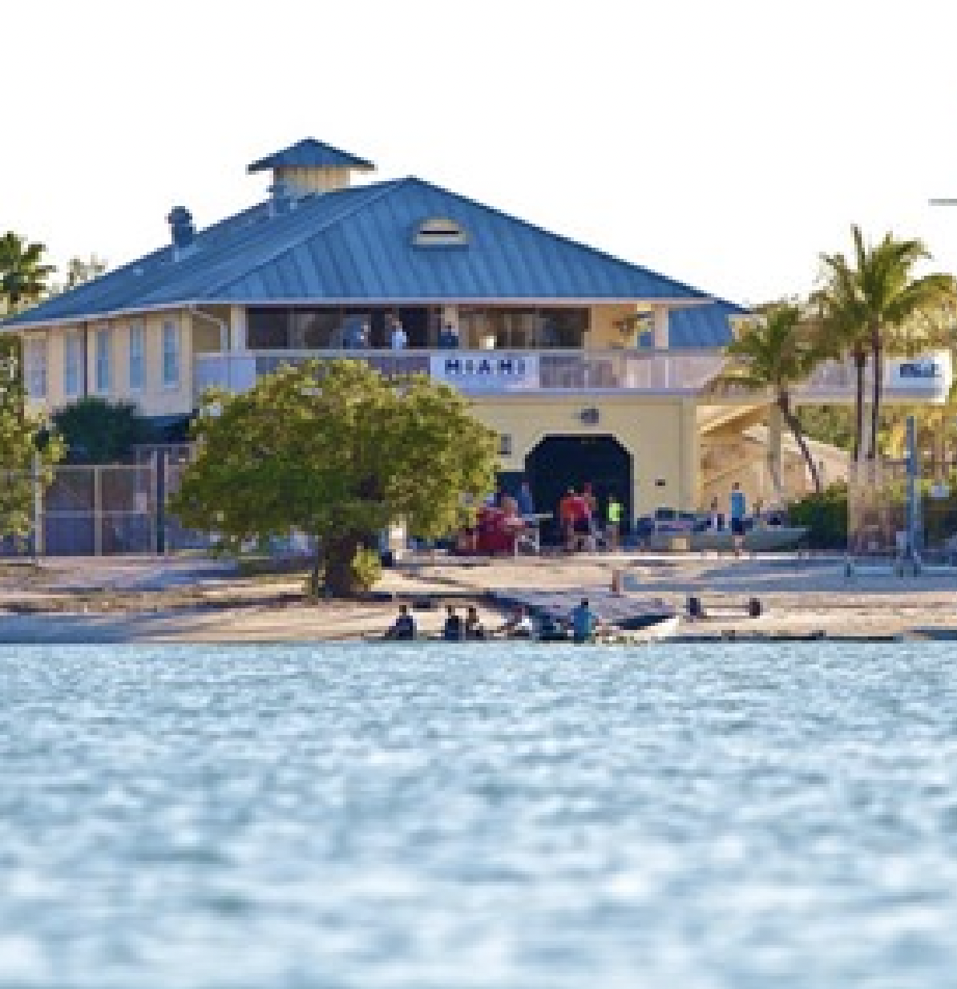
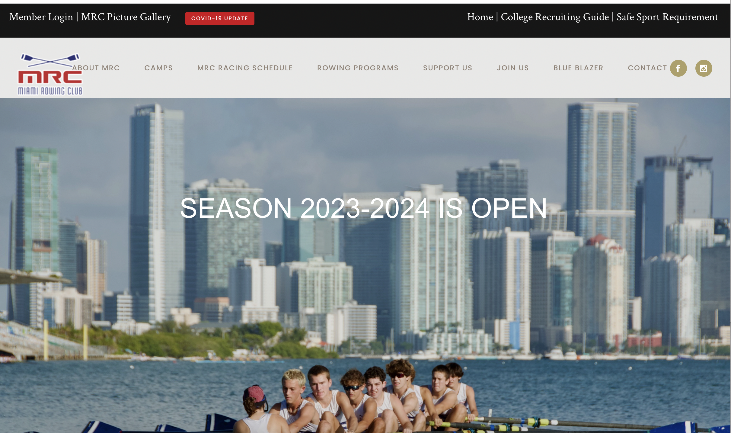
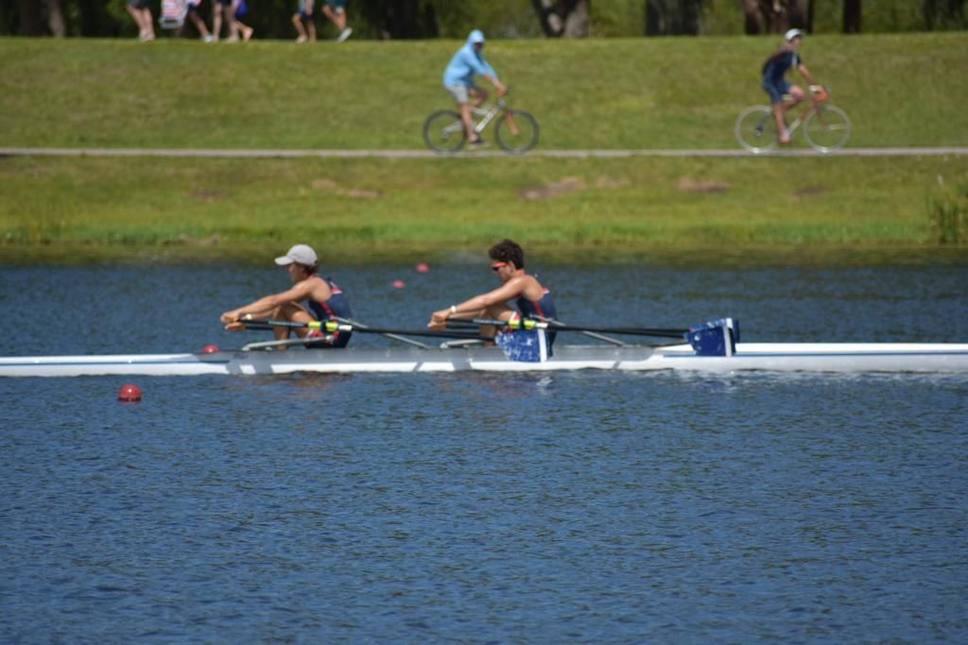
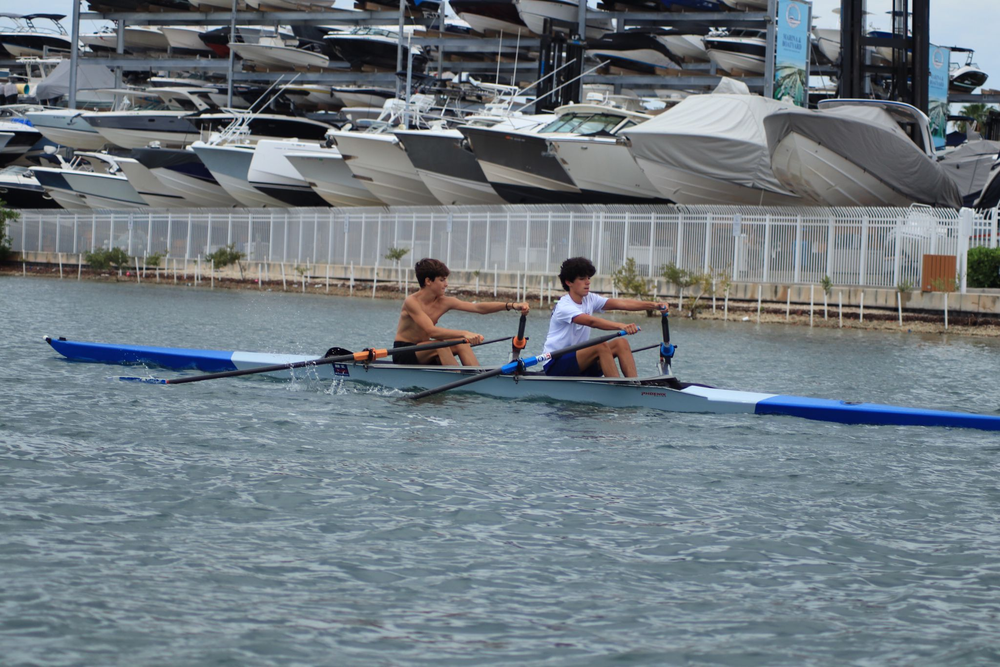
MRC TITANIUM SPONSOR
2024-2025
$45000
Exclusive Presenting Sponsor naming rights for the Miami International Regatta, Blue Blazer, Middle School Regatta
Your promotional banners prominently displayed throughout venue including MRC Boathouse terrace during events
Your Name/Logo on MIR VIP bracelets
Acknowledgment on MIR Press Releases and Social Media marketing campaigns
Stand alone tent and table for your promotional materials and team
Name on the Overall Winner of the MIR Regatta Trophy and MS Regatta
Naming Rights for (1) MIR Race
(12) VIP bracelets for MIR
Plus multiple year-long opportunities:
Naming Rights on Racing Boat
Name on set of 8 oars
Name/Logo on Custom practice shirt for all rowers
Name/Logo on Boat Trailer
Recognition at Blue Blazer/MIR/Award Dinner
Name/Logo on MRC Website
Social Media - Newsletter/Insta/FB 2x year
Name/Logo in club wide emails to MRC family
YOUR BANNER HERE
YOUR NAME HERE
YOUR NAME HERE

Slide 10
Other Opportunities
Platinum $25,000 | Naming Rights for (5) MIR Races 4 additional VIP access plus free parking benefits for up to 8 vehicles………PLUS GOLD benefits
Gold $15,000 | Name on Racing Boat 2 additional VIP access plus free parking benefits for up to 4 vehicles benefits ……PLUS SILVER benefits
Silver $10,000 | Name on set of 8 oars 2 additional VIP access plus free parking benefits for up to 4 vehicles benefits ………PLUS BRONZE benefits
Bronze $5,000 | Name/Logo on Custom practice spirit shirt for all rowers………PLUS Podium benefits Acknowledgement of MIR Press Releases and Social Media marketing campaigns. Stand-alone tent and table for your promotional materials and team. ½ Page Ad in the official Regatta Program. 4 additional VIP access plus free parking benefits for up to 2 vehicles….PLUS PODIUM benefits.
Podium $2,000 | Name/Logo on Boat Trailer Recognition at Blue Blazer/MIR/Award Dinner Promotional banners prominently displayed throughout the venue 1 Race event of your choice and the corresponding trophy will be named after your company and futured in the program. Social Media - Newsletter/Insta/FB 2x year VIP access for up to 2 people (free snacks and beverages) ……PLUS LAUNCH benefits
Launch $1,000 | Name/Logo in club wide emails to MRC family and MRC website with direct link to your website. Recognition on a small onsite MIR banner Recognition by the announcer during regatta

Slide 11
About Miami Rowing Club
Pasts Season Highlights
States 2022: A best-ever record of 16 medals won by the Varsity and Novice Squads, including 8 Gold Medals.
Youth Nationals 2022: Out of 210 teams participating and 778 entries representing states from all over the U.S., MRC participated with more than 2000 rowers in multiple U17 and U19 categories, and MRC won two silver medals.
USROWING Summer National U-23 Championship 2022: Out of teams and 52 entries, MRC won 4 Gold, 1 Silver and 2 Bronze medals.
USROWING Summer National U-19-17 Championship 2022: Out of 56 teams and 718 entries, MRC won 2 Silver and 2 Bronze medals.
Youth World Rowing Championships 2022: -5 MRC rowers qualified, and 3 competed in Italy.
Centro American Games 2023 in El Salvador: 5 MRC rowers were representing Puerto Rico
Head of the Charles 2022: For the first time in its history, MRC won 1 Gold Medal and finished in another 3 events in the top 10 in the country.
Head of the Hooch 2022: Was the best participation in years, 6 Gold, 4 Silver, and 3 Bronze Medals, and finished by the team in Second Place.
States 2023: A record of 14 medals won by the Varsity and Novice Squads, including 6 Gold,
Youth Nationals 2023: Out of teams participating and 225 entries representing states from all over the U.S., MRC participated with 32 rowers in multiple U17 and U19 categories and won 1 Gold and 1 Bronze Medals
USROWING Summer National Championship 2023: Out of 74 teams and 938 entries, MRC won 2 Bronze Medals.
Henley Regatta Londres UK. Our team participated in this prestigious regatta for the first time in our history.
States Championship 2024: Five Gold Medals, Four Silver, Two Bronze
Regionals Championship: Several Medals
Usrowing National Summer: Two Silver Medals and several boats on the top 6 of the Nation
Founded in 1973, Miami Rowing Club (MRC) is Miami’s premier rowing club, a 501(c)(3) organization with an active youth development program for our community
Central to the program at MRC is teaching young rowers respect for the legacy of participating in one of the oldest sports
MRC instills pride to be part of one of the fastest growing sports in the United States with over a 20% growth in the past 5 years. The Club is Open to all and age ranges from 12-70 years old
MRC Youth Rowers are a diverse group of students from all over Miami Dade County who have enjoyed decades of competitive success in local, state, regional, national and international competition
Volunteer-led, MRC relies on over 200 family members for all support and fundraising
MRC receives no financial assistance from the government, schools or other athletic programs

