Slide 1
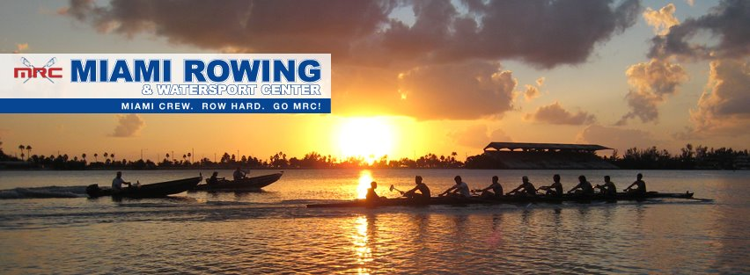
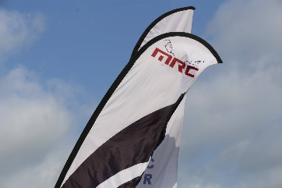
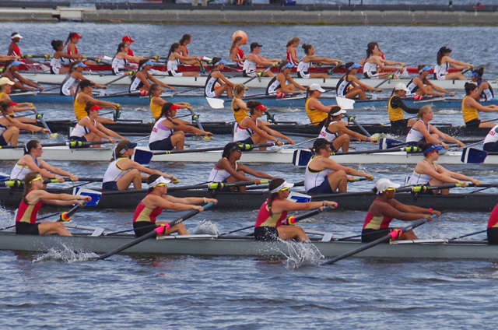
Welcome

Slide 2
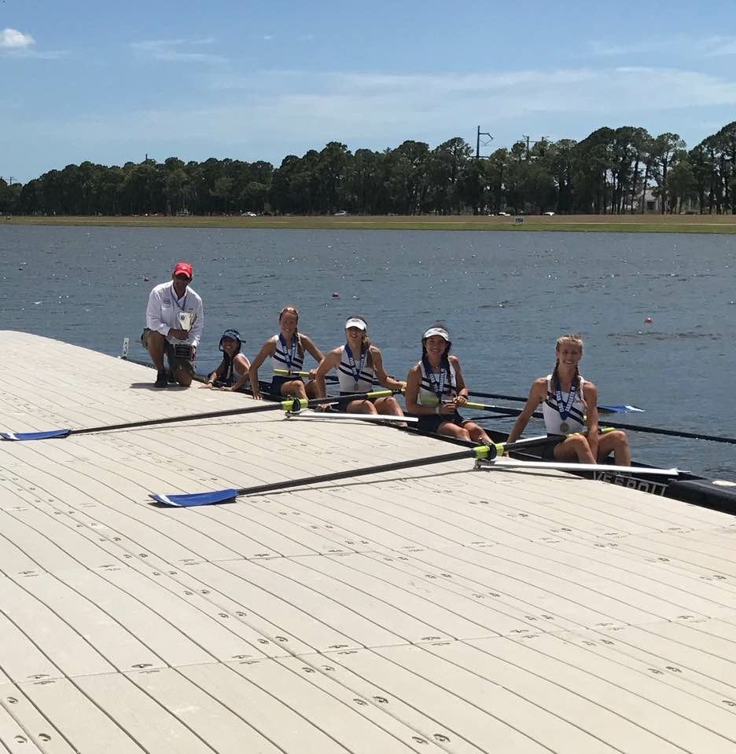
Season 2017-2018
YP program
Coaches:
Cesar Herrera--------------- Varsity Boys Coach
Yhoan Uribarri ------------- Varsity Girls Coach
Paul Sheller ----------------- Novice Girls Coach
Yamel Ortiz------------------ Novice Boys Coach/ /LTR/Adult Program
Jose Mendoza -------------- Assistant Girls Coach
Nick Nistal--------------------Assistant Boys Coach
Pasha Prykhodko---------- Assistant Novice Boys Coach
Xavier Mendez------------- Middle School Coach
Alena ------------------------Middle School Caoch

Slide 3
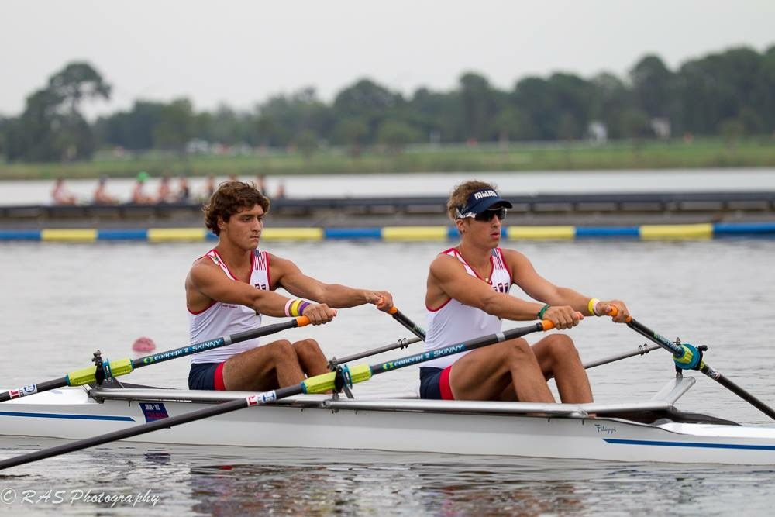
Season 2017-2018
COMMUNICATION:
A: TEAM UNIFY
B: WEBSITE
B: COACHES
GROUPS OF PARENTS:
A: LEADER
B: LEADER BY GROUPS
C: CLOTHE
D: RACES
E: MIR

Slide 4
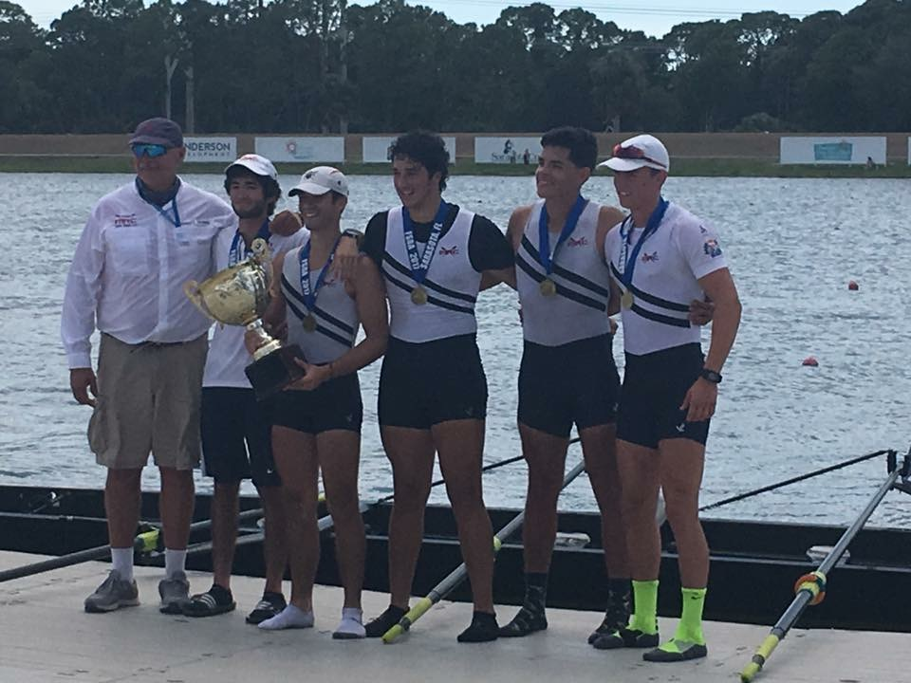
Season 2017-2018
YP Program
Novice and Fresh Girls
Varsity Girls
Varsity Boys
Novice and Fresh Boys
Middle School Program
Elite Camp
Sculling Camp

Slide 5
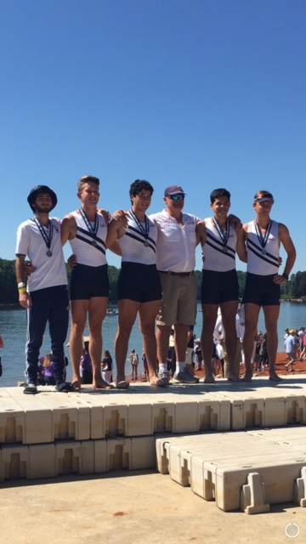
Season 2017-2018
YP program
GOALS: (Develop and improve)
Discipline
Technique
Results
Team Building
Physical Condition
Cohesion
Communication

Slide 6
Season 2017-2018
 | Mon. | Tues. | Wed | Thurs | Fri | Sat
Time: | 4:30 | 4:30 | 4:30 | 4:30 | 4:30 | 7am
Water | V-men N-women/ Fresh | V-women N-men/Fresh | N-men/Fresh V-women | V-men N-women/ Fresh | All Groups | All Groups
Off | Novice men/Fresh | Novice -women/ Fresh | V-men | V-women | N/A | N/A
DAYS OF DURING THE FALL SEASSON UNTIL DECEMBER
FROM JANUARY WE WILL HAVE TRAINING ALL THE WEEK WIHTOUT DAY OFF

Slide 7
Season 2017-2018
RACE | PLACE | GROUP | DATE
Head of the Charles | Boston | Boats accepted and rowers selected by coaches | 21-22 Oct 2017
Head of the Hooch | Chattanooga | Varsity Squad | 4-5 Nov 2017
Head of the Giblet | Turkey Lake, Orlando, FL | Novice Squad | 18-Nov-17
DUAL MEET | PAINCREST SCHOOL | SQUAD | 28-Jan-18
Novice Regatta | Turkey Lake, Orlando | Novice Boys and Novice Girls | 3-Feb 2018
Erg Spring | Melbourne, Fl | Open to the squad | 10-Feb 2018
Sarasota Invitational | Sarasota | SQUAD | 24-Feb-18
OARS Invitational | Turkey Lake, Orlando, FL | SQUAD | 10-Mar-18
45 Miami International Regatta | Miami | SQUAD | 31-Mar-18
States Sculling Championship | SARASOTA | Rowers Select in Sculling | 14-15 APRIL 2018
States Sweep Championship | SARASOTA | Rowers Select in Sweep | 28-29 APRIL 2018
Regional Championship | SARASOTA | Squad | 12-13 MAY 2018
AMERICAN CUP | SARASOTA | BOATS QUALIFIED TO NATIONAL | TBA
Youth National | RANCHO CORDOVA, CALIFORNIA | Qualified Boats | 6 to 10 JUN 2018
Club National | TBA | Elite Camp | TBA

Slide 8
Season 2017-2018
Middle School
First Section
Sept 4 to Dec 14
Mo/Tu/Wed/Thu
Time: 4:30 to 6:30
2 days per week
Coach:
XAVIER AND ALENA
Middle School
Second Section
January 8 to April 12
Mo/Tu/Wed/Thu
Time: 4:30 to 6:30
2 days per week
Coach: XAVIER AND ALENA

Slide 9
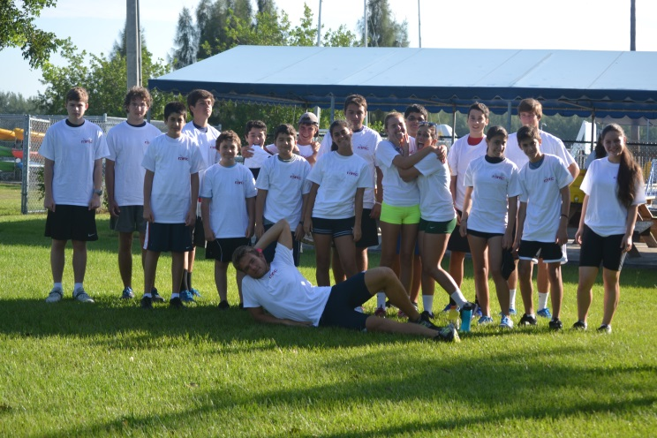
Season 2017-2018
Days:
April 17 to Jun 8
3 days per week
Summer Camp 2018
Coaches
Staff
Days:
5 days per week
Five Section
Coaches
Staff
Sculling Camp

Slide 10
